Slide 1
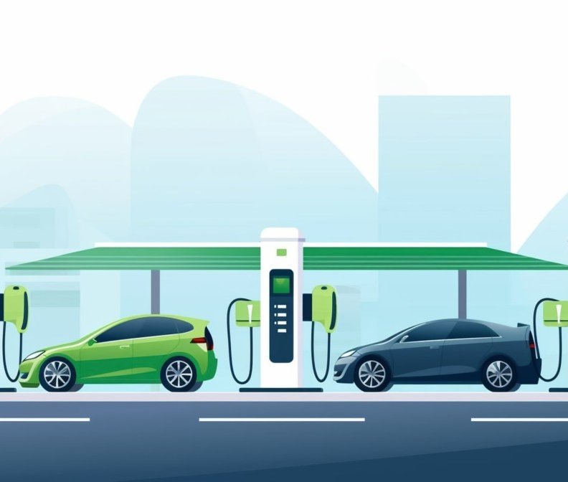
Electric Vehicle Charging Stations Dashboard
Contributors: Alberto Alvarado, Karina Gonzalez, Angelie Wanner

Slide 2

Welcome to our dashboard!
The EV Charging Stations Dashboard is exactly what it sounds like – it provides you with locations of available EV charging stations across the U.S.
Name of the station
Address
Phone Number
Charge fee

Slide 3

EV Interesting Facts
161,562 EV charging stations in the U.S. in 2023*
Charger Levels**
Level 1: 120V AC, takes 40-50+ hours for 80% charge
Level 2: 240V AC, takes 4-10 hours for 80% charge
Level 3: Direct current fast charging (DCFC), takes 20mins-1hour for 80% charge
Connector Types**
J1772 – Level 1 and Level 2
CCS – Level 3
CHAdeMO – Level 3
Tesla (SAE J3400) – Level 2 and Level 3
Future of EV charger connectors – Tesla is setting the stage as the standard charger across EV chargers***
* FOTW #1299, July 17, 2023, Department of Energy
** Charger Types and Speeds, U.S. Department of Transportation
*** ‘Welcome to EV dongle town’, The Verge
Notes:
Notes:
- Level 1 provides charging through a common residential, so think your home outlet
- Level 2 is common for home, workplace, and public charging
- Level 3 offers rapid charging along heavy-traffic corridors at installed stations
Level 2 and DCFC equipment has been deployed at various public locations including, for example, at grocery stores, theaters, or coffee shops.
J1722 and CCS are the more common non-Tesla charger connectors in the U.S. Only the Nissan Leaf and Mitsubishi Outlander PHEV still use CHAdeMO in North America.

Slide 4

Process
Data collection, cleanup and updates on Jupyter
CSV to JSON
MongoDB database
Javascript for visualizations
HTML

Slide 5
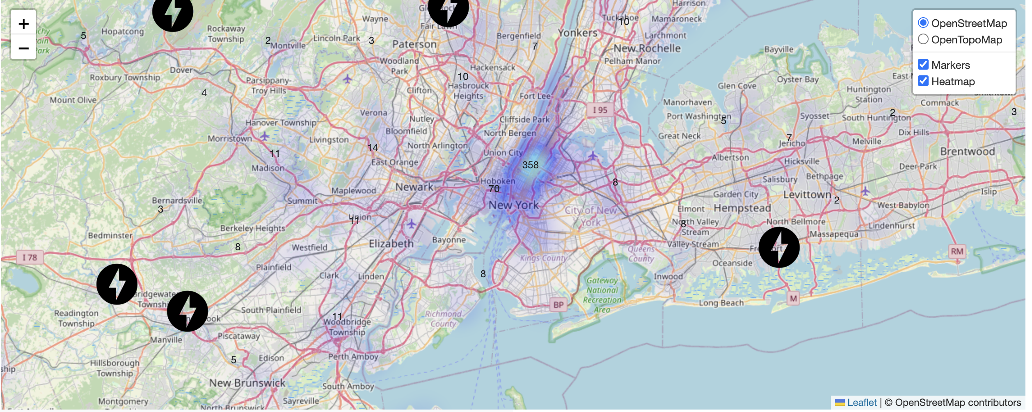
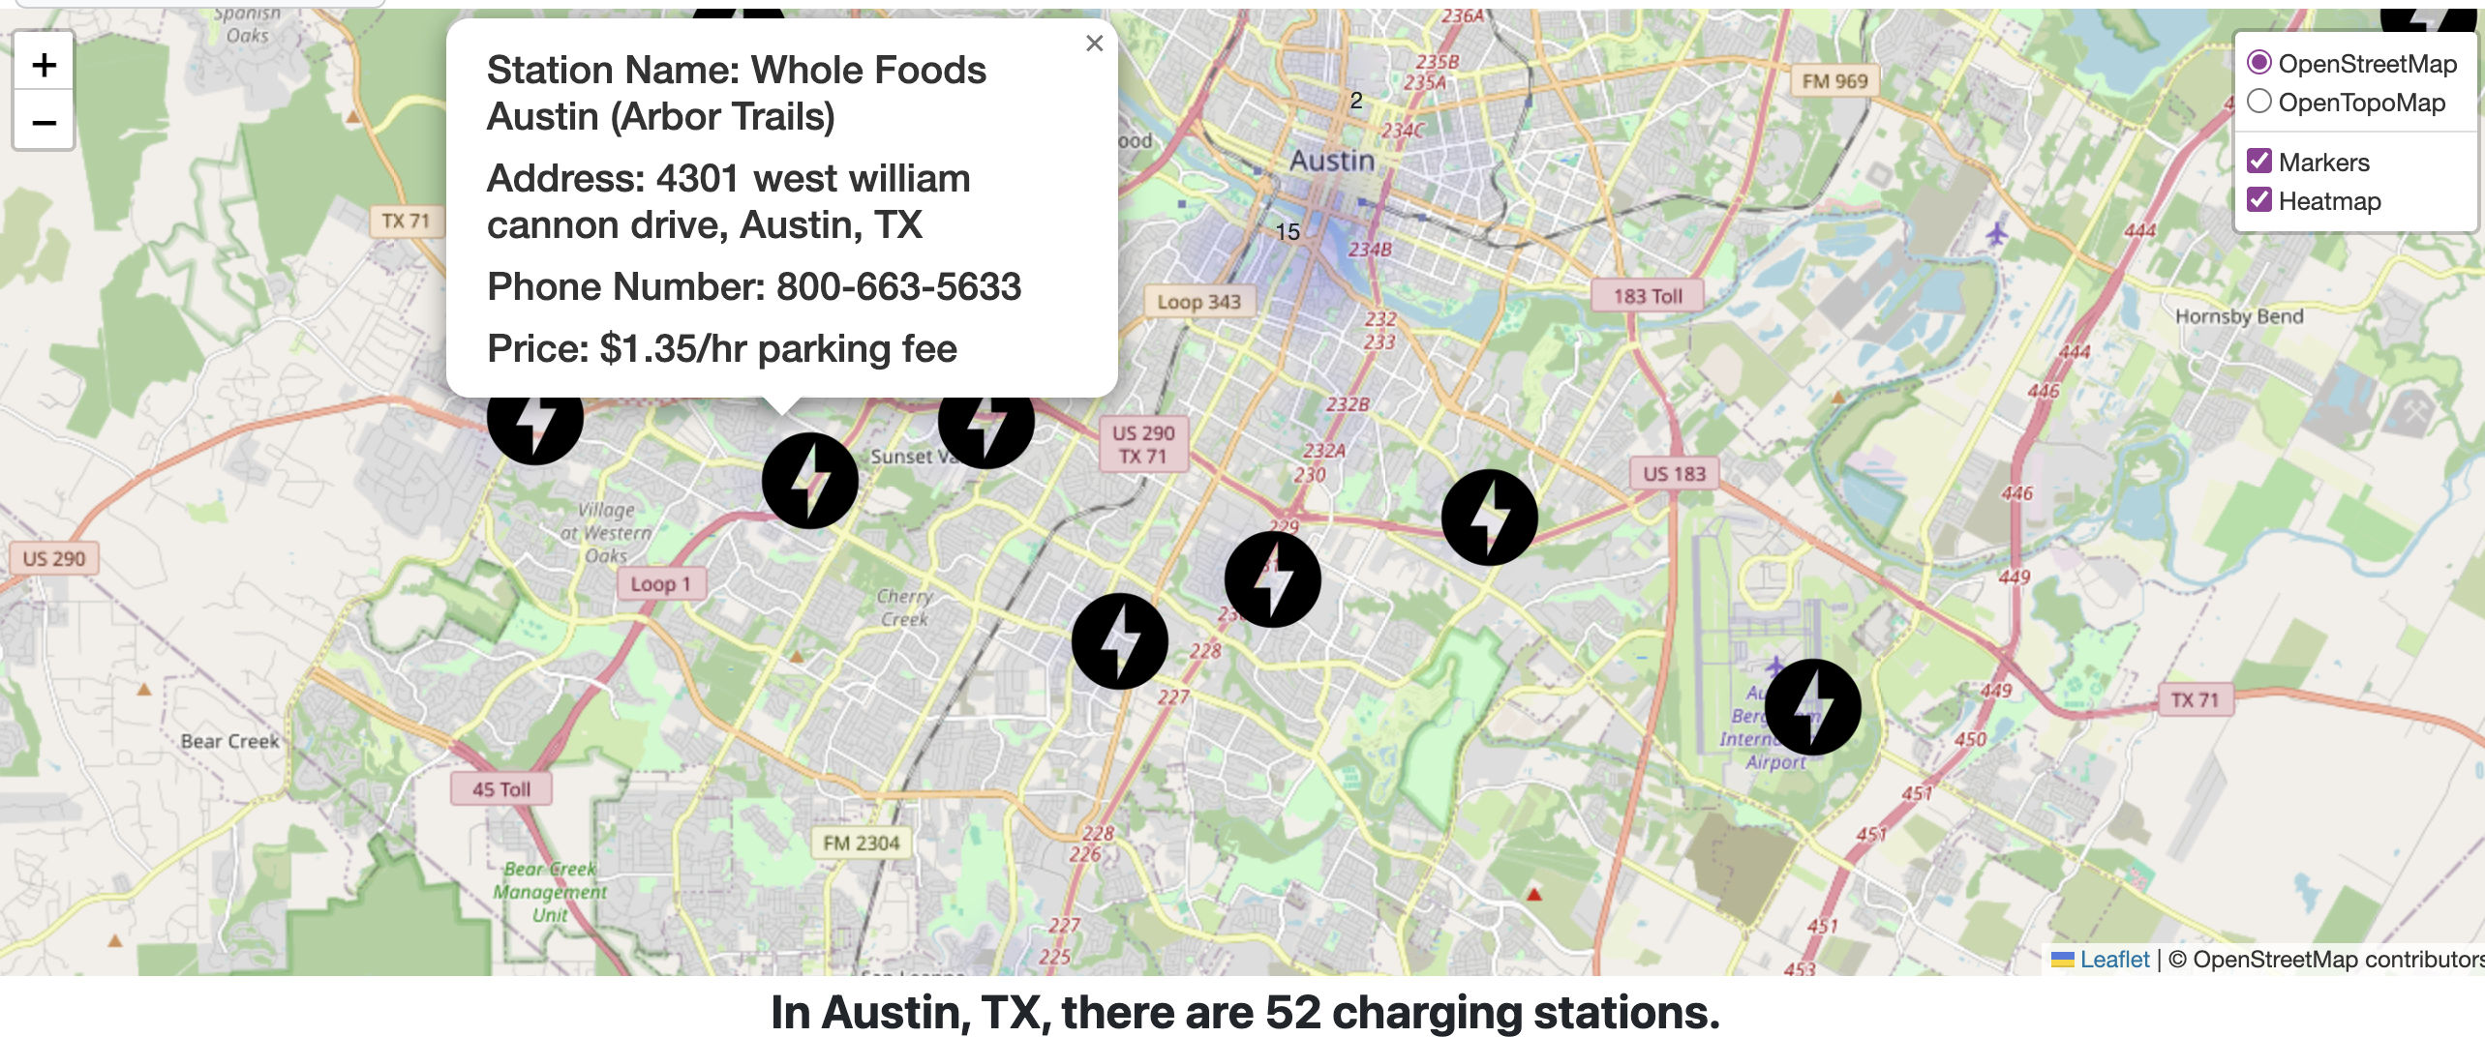
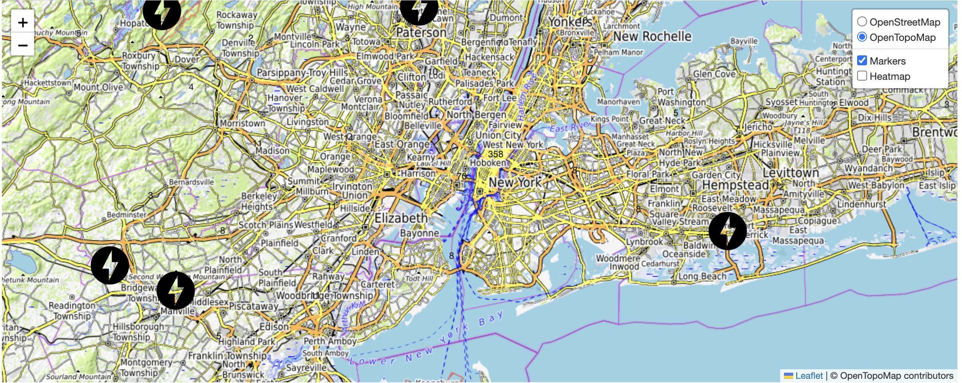
Visualization 1
Heatmap layer allows the user to visualize where majority of EV charging stations are located.
Markers provide information on each EV charger such as address, phone number, and price when clicked on.

Slide 6
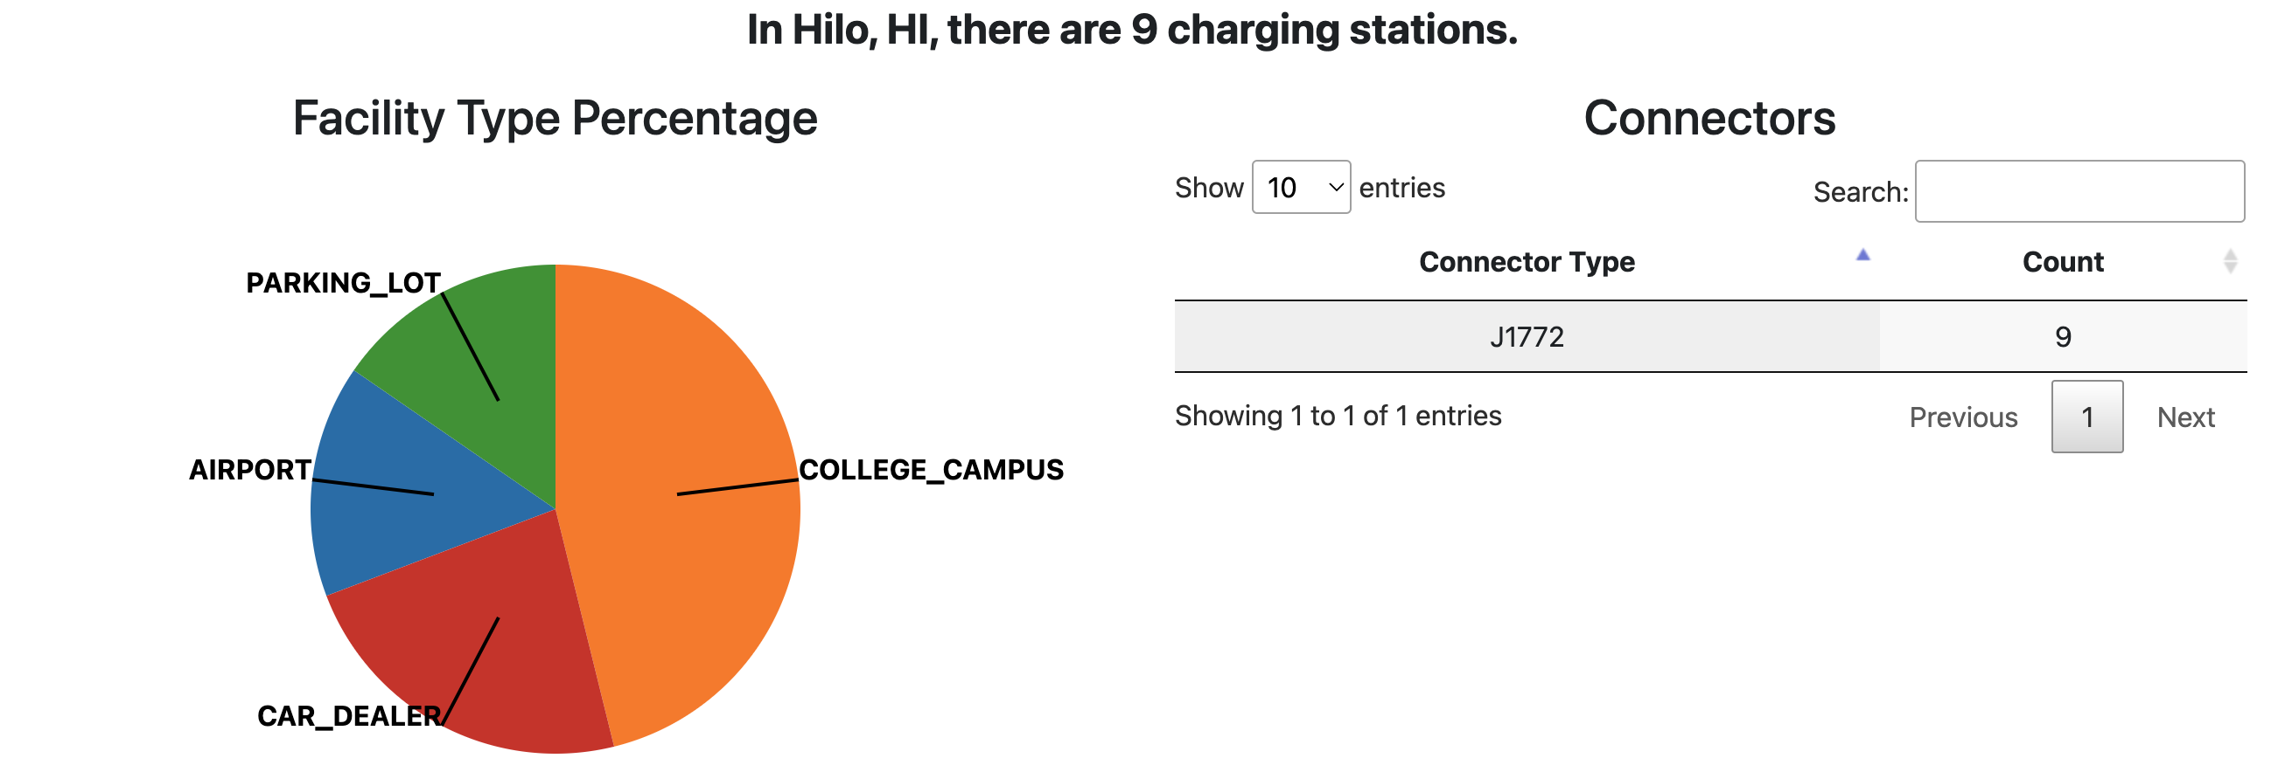
Visualization 2
With the selected state and city the dashboard creates the visualizations shown to the right
The Pie chart provides insights into the distribution of charging stations based on the type of facilities they are located in.
This table provides a breakdown of charging stations categorized by their respective connector types, such as CHAdeMO, CCS, Tesla Supercharger, etc.

Slide 7
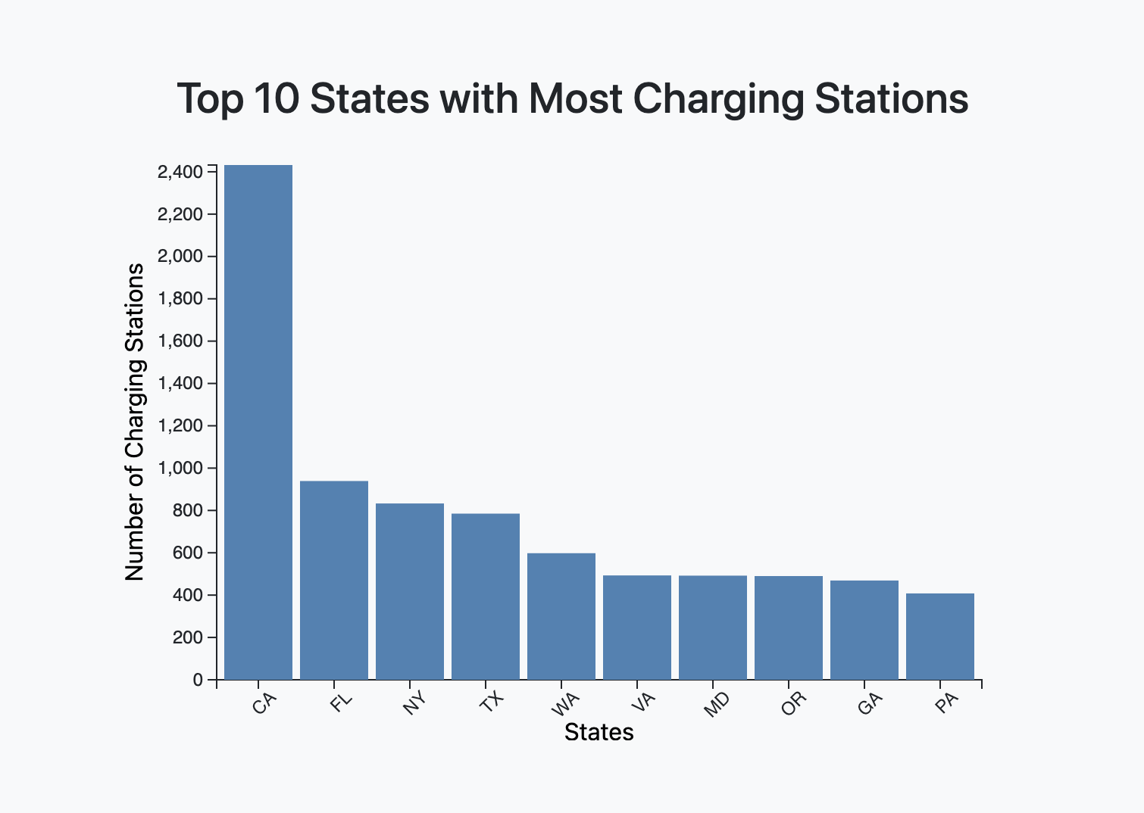
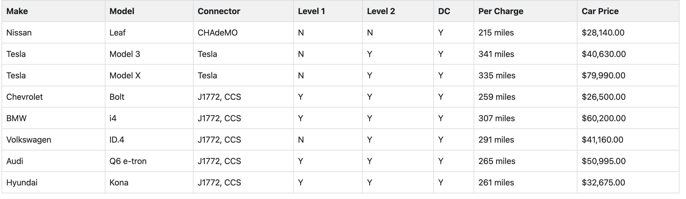
Visualization 3
A static visualization of Vehicle types and details.
A visualization of the ten states with the most amount of stations in the United states.

Slide 8

Future Possibilities
There are many potential possibilities for enhancements to this dashboard.
additional drop down to show only locations with specific level types or connector types
API calls instead of static csv
input from user (i.e. address) and provide listing of nearby charging stations

Slide 9

Sources
Datasets:
https://data-usdot.opendata.arcgis.com/datasets/alternative-fueling-stations/explore?location=34.136136%2C-98.731784%2C6.62
https://developer.nrel.gov/docs/transportation/alt-fuel-stations-v1/all/
Research:
https://datatables.net/manual/
https://stackoverflow.com/questions/13733133/getting-started-with-datatables

